Slide 1
Angular Upskilling Program
Services

Slide 2

Angular Services - Introduction
Web applications implements the Client-Server architecture, where the client will need to fetch data from the server in order to dynamically render it.
In order to respect the Single Responsibility principle in an Angular application, it is needed to separate the logic of fetching data, from the Component to the Service Layer.
Services are Singleton classes that needs to belong to a provider in order to be injected in the constructor of a component.
Note: You should be careful because the services could behave differently if you are using lazy
loading modules.

Slide 3
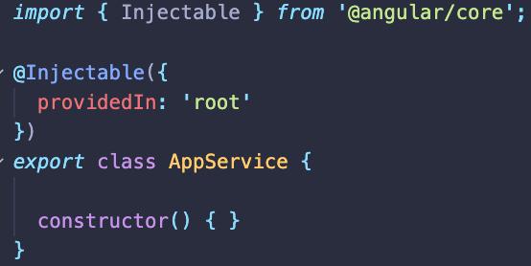
Angular Services
In order to define a service it is needed to decorate de class with the @Injectable decorator and optionally specify the name of the module to act as a provider for it.
Services can act as a single source of trust for a particular module of an application since it’s purpose is to contain logic related to a single topic and it persists the data due to its Singleton behavior.
Services can be used as a channel for communication between components instead of using the @Input and @Output decorators.
Note: It is recommended to use only providedIn: ‘root’ in order to avoid circular dependencies.

Slide 4
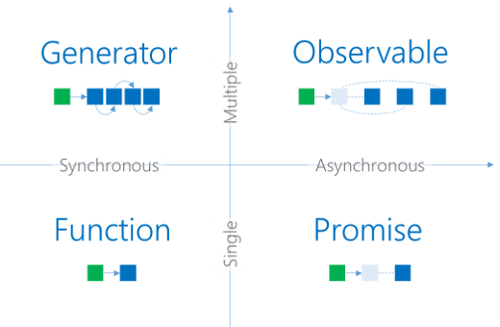
Observables

Slide 5
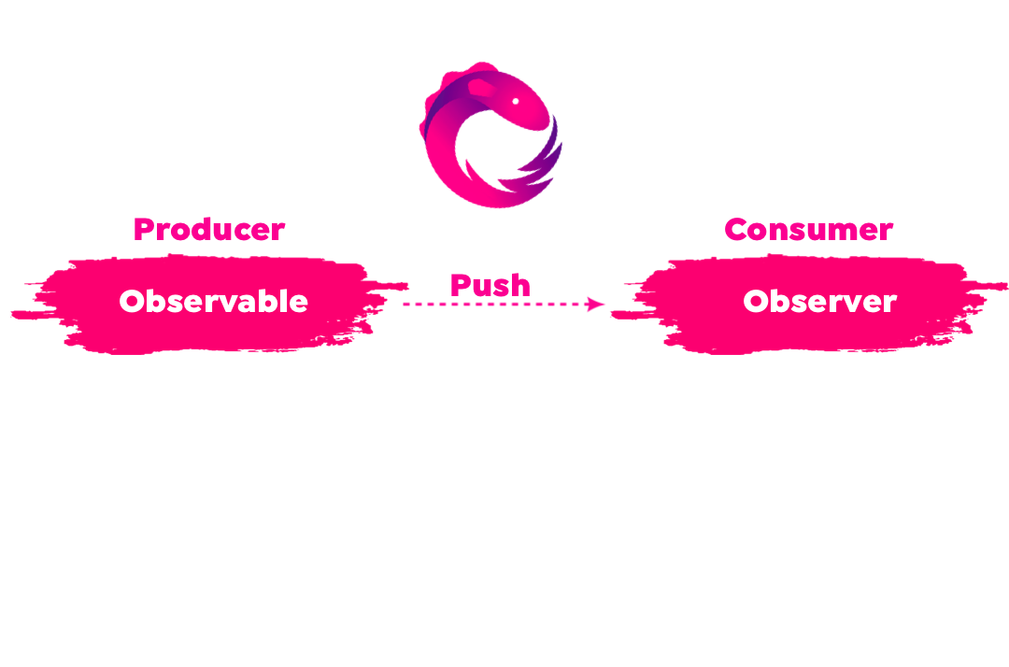
Observables
There are two approaches that can describe the Producer-Consumer pattern: push and pull. The pull approach assumes that the producer does not know where the value will be consumed and does not have any control about it. The push pattern is different because the producer has all the control about how the data is passed to the consumer and pushes the values accodingly.
Observables are a push system producers responsible for emitting values by wrapping a data source.

Slide 6
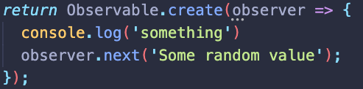
Observables
Terminology:
Observer: represents the API for the consumer/reader of the data stream.
Subscriber: the subscriber is an extension of the Observer but with capabilities of unsubscription.
Subscription: the communication channel between the observable and the observer that guarantees that an observer receives data.
Supported operations:
next: The observer sends a value that can be a primitive or an object.
error: Will throw an exception and cancel the execution of the rest of the observer.
complete: Notifies the subscriptions for the observable that all the data is completed.

Slide 7
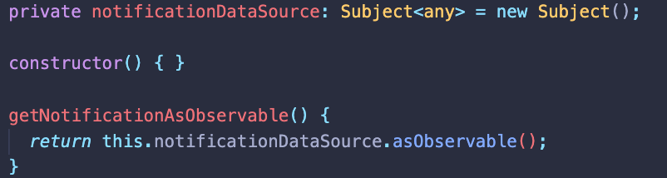
Subjects
A subject is a special type of Observable that allows it to behave as an Observable and an Observer in the same time.

Slide 8
State Management with Subjects
In Angular applications component communication is done by using @Input and @Output decorators. But how data should be transferred when the components are not coupled in the parent-child relationship?
There is a special type of Subject that holds only the last emitted value on the stream to all observers, called BehaviorSubject
Services that are using BehaviorSubject are ideally for the state management in an Angular application, if no third party libraries like NgRx are wanted. Their initialization requires an initial state which canot be mutated directly because when a new value is emitted, a new state is created.
Services are singletons, so keeping state in a service would respect the following state management principles:
Single source of trust: State is not spread across multiple components that can mutate it;
State persistence: Services are singletons
Ease of debugging

Slide 9


